Slide 1
Unit 3 - Architectural Styles

Slide 2
ARCHITECTURAL STYLES
Introduction
Data flow styles
  Call-return styles
  Shared Information styles
  Event styles
Case studies for each style.

Slide 3
What is Architectural style ?
Software Architecture is described as the organization of a system, where the system represents a set of components that accomplish the desired functions.
Component: represents computation
Connectors: facilitate component communication
Architectural Style
Components + Connectors + Constraints
Constraints: how components and connectors may be combined e.g., a component may be connected to at most two other components, a hierarchy of components, sequential processing of data, asynchronous communication.
Architectural styles define the components (building blocks) of a system and the connectors (communication mechanisms) that enable interactions between these components.
Each architectural style serves a specific purpose and addresses particular concerns or requirements. For example, some styles focus on scalability, while others prioritize security or ease of maintenance.
The software that is built for computer based systems exhibit one of many architectural styles.

Slide 4
What is Architectural style ?
A set of design rules that identify the kinds of components and connectors that may be used to compose a system or subsystem, together with constraints on the way the composition is done. [Shaw and Clements, 1996] i.e., family of systems in terms of a pattern of structural organization
These features and rules are called “Architectural style”.
Architectural styles are design patterns that define the structure and organization of a software system. They provide a set of predefined solutions to common architectural problems.
Architectural styles offer a structured approach to designing software systems, making them easier to understand, maintain, and scale.

Slide 5
Archetypes
In software architecture, archetypes are abstract building blocks that represent the core components or roles within a system. They act as templates or high-level patterns that define standard types of entities in a system, helping to structure and organize the architecture. Archetypes are used as a foundational layer for designing software, especially in complex systems, because they provide a conceptual framework for how components interact and fulfill the system’s purpose.
Key Characteristics of Archetypes:
High-Level Abstraction: Archetypes define broad, high-level components rather than detailed implementations.
Reusability: They provide a reusable structure applicable across different types of systems, especially within the same domain.
Role Definition: Archetypes outline specific roles or responsibilities each component fulfills, which makes them flexible for adaptation.

Slide 6
Archetypes
Common Archetypes in Software Architecture
Entity: Represents core data or business objects in the system, such as a Customer, Product, or Order. Entities are generally persistent and store essential information within the system.
  Example: In an e-commerce system, entities would include objects like Customer, Order, and Product, each storing relevant data.
Boundary: Acts as an interface between the system and external agents (like users or other systems). Boundary archetypes handle input/output and often include user interfaces or APIs.
  Example: In a web application, the boundary archetype could be represented by a Web Controller or REST API that processes HTTP requests.
Controller: Manages the logic that coordinates between boundaries and entities, often handling the flow of data. Controllers act as intermediaries, executing application logic and ensuring interactions are efficient and cohesive.
  Example: In an online payment system, a PaymentController would coordinate between user input from the boundary and transaction data in the entities.
Service: Provides business logic and computations that might be reused across multiple parts of the system. Services often perform domain-specific operations that are independent of specific entities.
  Example: In a finance application, a TaxCalculationService might calculate taxes on transactions, and multiple parts of the application could use it without duplicating tax computation logic.
Manager (or Coordinator): Orchestrates and controls complex workflows by coordinating different services and components to complete tasks that involve multiple steps.
  Example: In a healthcare system, an AppointmentManager could coordinate actions between different entities like Doctor, Patient, and Schedule to book an appointment.

Slide 7
Archetypes
In a Banking Application, the archetypes might look like this:
Entity: Represents the primary data objects, such as Account, Transaction, and Customer.
Boundary: The web/mobile interface through which customers interact or the ATM interface allowing cash withdrawal.
Controller: Controls the workflow, such as an AccountController that manages transactions between accounts.
Service: Provides functionalities, like an InterestCalculatorService that computes interest on deposits.
Manager: Coordinates tasks, such as TransactionManager that ensures all transactions (withdrawals, deposits) follow the correct business rules.

Slide 8
Common styles
Data-flow Architectures
  Batch sequential
  Pipe and filter
Call and Return Systems
  Main program and subroutines
  Object-oriented Systems
Shared Information Styles / Data Centered Architectures
  Repository
  Blackboard
  Rule based
Implicit invocation
  Event-based
  Publish-subscribe
Layered
  Virtual machines
  Client-server

Slide 9
DATAFLOW STYLE
A Data Flow Architecture is a way of designing a system where data moves through various processing steps or components. Each component processes the data and passes it to the next one. This is similar to how an assembly line in a factory works, where each station performs a specific task on a product as it moves along the conveyor belt.
In data flow architecture, the whole software system is seen as a series of transformations on consecutive pieces or set of input data, where data and operations are independent of each other.
The connections between the components or modules may be implemented as I/O stream, I/O buffers, piped, or other types of connections.
The data can be flown in the graph topology with cycles, in a linear structure without cycles, or in a tree type structure.
Three types of execution sequences between components
  Batch Sequential
  Pipe and Filter

Slide 10
DATAFLOW STYLE – web app for image processing
Input Component: This is where a user uploads an image to the system. The input component receives the image data.
Image Processor: The image processor takes the uploaded image and performs tasks like resizing, cropping, and color correction.
Text Overlay Component: This component adds text to the processed image, like a watermark or caption.
Filter Component: The filter component applies various filters to the image, such as making it grayscale or adding special effects.
Output Component: Finally, the processed image is sent to the output component, which might display it on a webpage or allow the user to download it.
In this architecture, data (the image) flows sequentially through each component, with each one performing a specific task. This modular approach makes it easy to update or replace individual components without affecting the entire system.
For example, if you wanted to change the way images are filtered, you could modify the Filter Component without touching the other parts of the system. This makes the system flexible and maintainable, which are key benefits of a data flow architecture.

Slide 11
BATCH SEQUENTIAL STYLE
Batch Sequential Architecture is a type of software architecture where processing occurs in batches, with each batch following the previous one in a sequential manner. It is commonly used in scenarios where data processing needs to occur in large volumes or in a specific order,
The flow of data carries a batch of data as a whole from one subsystem to another.
Processing steps, or components, are independent programs.
It is applicable for those applications where data is batched, and each subsystem reads related input files and writes output files.
Typical application of this architecture includes business data processing such as banking , utility billing, Payroll computations, Tax reports, Patient management, student management, library management etc.

Slide 12
BATCH SEQUENTIAL STYLE – Key Characteristics
Sequential Processing: In this architecture, tasks are executed one after the other in a predefined sequence. Each task typically relies on the output of the previous task, creating a clear flow of data and operations.
Batch Processing: Processing is done in batches, meaning that a set of data or a group of similar tasks are processed together. For example, in ETL processes, data is collected over a period (batch), transformed together, and then loaded into a database.
Data Dependencies: Tasks within the architecture often have dependencies on the data produced by previous tasks. This ensures that data is processed in a consistent and coherent manner.
Scalability: Batch sequential architectures can be designed to be scalable, meaning that they can handle larger volumes of data by processing more batches in parallel or by distributing the workload across multiple server

Slide 13
BATCH SEQUENTIAL STYLE – Example – Processing sales data
Data Collection (Batch 1): In the first batch, data is collected from various stores. Each store submits its daily sales data to the central system. This batch includes data files from all the stores.
Data Validation (Batch 2): Once Batch 1 is complete, Batch 2 starts. It validates the data collected in Batch 1, checking for errors or missing information.
Data Transformation (Batch 3): Batch 3 transforms the validated data into a standardized format. It may involve converting currency, aggregating sales by product category, or applying data cleansing.
Data Analysis (Batch 4): In Batch 4, the transformed data is analyzed to generate reports. For instance, it can calculate total sales, generate profit margins, and identify trends.
Data Reporting (Batch 5): The final batch generates reports based on the analyzed data. These reports might be used by executives, store managers, or for regulatory compliance.

Slide 14
BATCH SEQUENTIAL STYLE – Adv.
Consistency: Since tasks are executed in a fixed sequence, the data is processed consistently.
Error Handling: Errors can be identified and addressed at each stage, ensuring data quality.
Resource Management: Resources can be allocated based on expected batch sizes and processing times.
Predictability: The predictable nature of batch processing makes it suitable for many business scenarios.
Challenges of Batch Sequential Architecture:
Latency: Real-time processing is not possible, which may be a limitation for some applications.
Complexity: Managing dependencies between batches and tasks can become complex as the architecture scales.
Scalability: Scaling may require additional hardware or more efficient scheduling systems.
May not be suitable for real-time systems or those requiring immediate responses.

Slide 15
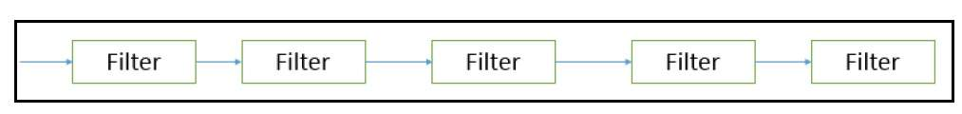
Batch-Sequential

Slide 16
Batch sequential style
Design elements
  Components - Independent programs
  Connectors – human hand carrying tapes between the programs
  Data – aggregated on tapes
  Topology – linear

Slide 17
Pipe and Filter
Pipe and Filter Architecture Style is a software architectural style where data processing tasks are organized into a linear sequence of processing steps.
Each step, called a "filter," takes input data, processes it, and produces output data. These filters are connected together using "pipes," which facilitate the flow of data from one filter to another.
This style is commonly used in scenarios where data needs to undergo multiple transformations or processing steps in a well-defined order.

Slide 18
Pipe and Filter - Characteristics
Sequential Processing: Filters are executed sequentially, and each filter in the chain performs a specific data transformation or processing operation.
Modularity: Each filter is modular and focuses on a specific aspect of data processing. This modularity promotes reusability and maintainability.
Data Flow: Data flows from one filter to another through pipes. Filters are loosely coupled, as they only need to understand the data format they receive and produce.
Independence: Filters can be developed and tested independently. As long as they adhere to the agreed-upon data format, they can be plugged into the pipeline.
Parallelism: In some cases, multiple filters can be executed in parallel if they do not have dependencies on each other.

Slide 19
Pipe and Filter – Text Proc. Sys
Input Filter: This filter reads raw text data from a file or a user input source and converts it into a standardized format.
Tokenizer Filter: The tokenization filter receives the standardized text data and breaks it into individual words or sentences. It produces a stream of tokens.
Filter A - Word Count: Filter A counts the number of words in the text by processing the stream of tokens. It produces a count.
Filter B - Spell Check: Filter B checks the spelling of each word in the stream of tokens. It flags misspelled words.
Filter C - Text Analysis: Filter C analyzes the content of the text, looking for specific keywords or patterns. It produces an analysis report.
Output Filter: The output filter takes the results from Filters A, B, and C, and formats them for display or storage. It may create a summary report with word count, spelling errors, and analysis results.
In this example, each filter performs a specific task, and data flows sequentially from one filter to the next through pipes. The architecture allows for easy extensibility by adding or modifying filters.

Slide 20
Pipe and Filter – Advantages
Modularity: Filters can be developed and tested independently, promoting code reusability.
Flexibility: Filters can be combined and reconfigured in various ways to achieve different processing tasks.
Maintainability: Changes or updates to one filter do not necessarily affect others in the pipeline.
Challenges of Pipe and Filter Style:
Limited Interaction: Filters have limited interaction with each other, which may not be suitable for scenarios requiring complex coordination.
Sequential Processing: Real-time or concurrent processing may be challenging, depending on the architecture's design.
Data Format Consistency: Filters must adhere to a consistent data format to ensure proper data flow.
Pipe and Filter is a versatile architectural style suitable for applications involving data transformation, data analysis, and other sequential processing tasks. It is commonly used in scenarios such as text processing, image processing, and data ETL (Extract, Transform, Load) pipelines.

Slide 21
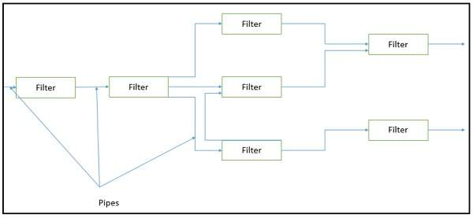
Pipe and Filter

Slide 22
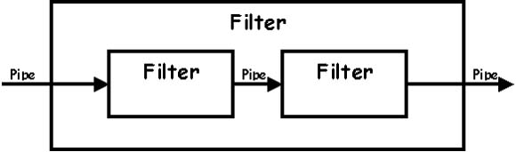
Pipe and Filter

Slide 23
Dataflow
( Pipe and Filter) …
Design elements
  Components – independent programs a.k.a filters
  Connectors – routers of data streams (pipes), provided by an operating system
  Data – linear data streams traditionally - text
Topology
  Usually linear pipelines

Slide 24
Dataflow Architecture Problems
In a manufacturing facility, a batch process is used to produce a chemical product. Each batch takes 4 hours to complete, and the facility operates continuously in three shifts. Calculate the daily production output in batches.
In a distributed data processing system, there are three data processing nodes: Node A, Node B, and Node C. Data is transmitted between nodes with varying latencies. The latency from Node A to Node B is 5 milliseconds, from Node B to Node C is 8 milliseconds, and from Node C back to Node A is 6 milliseconds. Calculate the round-trip latency for data sent from Node A to Node C and back.

Slide 25
Dataflow Architecture Problems
In a manufacturing facility, a batch process is used to produce a chemical product. Each batch takes 4 hours to complete, and the facility operates continuously in three shifts. Calculate the daily production output in batches.
  The facility operates continuously in three shifts, which means it operates for 24 hours a day. In 24 hours, there are 24 / 4 = 6 sets of 4-hour batches. Therefore, the daily production output in batches is 6.
In a distributed data processing system, there are three data processing nodes: Node A, Node B, and Node C. Data is transmitted between nodes with varying latencies. The latency from Node A to Node B is 5 milliseconds, from Node B to Node C is 8 milliseconds, and from Node C back to Node A is 6 milliseconds. Calculate the round-trip latency for data sent from Node A to Node C and back.
  To calculate the round-trip latency for data sent from Node A to Node C and back, you sum the latencies for each leg of the trip:
  Round-Trip Latency = (Node A to Node B) + (Node B to Node C) + (Node C back to Node A) Round-Trip Latency = 5 ms + 8 ms + 6 ms = 19 ms
  So, the round-trip latency is 19 milliseconds.

Slide 26
Dataflow Architecture Problems
Consider a client-server application. The client sends requests to the server, and the server processes these requests. On average, the client sends 20 requests per second, and the server takes 15 milliseconds to process each request. Calculate the server's throughput in requests per second.
  Throughput is calculated as the number of requests processed per unit of time.
  Throughput = Number of Requests Processed / Time
  In this case, the server processes 20 requests per second. Therefore, the server's throughput is 20 requests per second.
In a software system following a layered architecture, there are five layers: Presentation, Business Logic, Data Access, Database, and Hardware. If a request initiated from the Presentation layer takes 4 milliseconds to traverse all the way to the Data Access layer, calculate the average traversal time through one layer.
  The average traversal time through one layer can be calculated by dividing the total traversal time by the number of layers. In this case, the traversal time from Presentation to Data Access is 4 milliseconds, and there are 5 layers. Average Traversal Time = Total Traversal Time / Number of Layers Average Traversal Time = 4 ms / 5 layers = 0.8 ms per layer
  So, the average traversal time through one layer is 0.8 milliseconds.

Slide 27
Dataflow Architecture Problems
In a video processing pipeline, there are five filters connected in series. Filter A processes frames at 30 frames per second (fps), Filter B at 40 fps, Filter C at 25 fps, Filter D at 35 fps, and Filter E at 50 fps. Calculate the overall frames per second output of the pipeline.
  Overall frames per second output = (Frames per second of Filter A) x (Frames per second of Filter B) x (Frames per second of Filter C) x (Frames per second of Filter D) x (Frames per second of Filter E)
  Overall frames per second output = 30 fps x 40 fps x 25 fps x 35 fps x 50 fps = 131,250 fps
In a data processing pipeline, data flows through three filters sequentially. Filter A processes data at a rate of 50 records per second, Filter B processes data at a rate of 60 records per second, and Filter C processes data at a rate of 40 records per second. Calculate the overall data processing rate of the pipeline.
  Overall processing rate = (Processing rate of Filter A) x (Processing rate of Filter B) x (Processing rate of Filter C) Overall processing rate = (50 records/second) x (60 records/second) x (40 records/second) Overall processing rate = 120,000 records/second

Slide 28
Dataflow Architecture Problems
In a batch processing system, a company produces 1000 widgets per batch. Each batch takes 2 hours to complete, and they run 5 batches per day. Calculate the daily production rate in widgets per hour.
  Daily production rate = (Number of batches per day) x (Widgets per batch) / (Time per batch in hours)
  Daily production rate = (5 batches/day) x (1000 widgets/batch) / (2 hours/batch)
  Daily production rate = 2500 widgets/hour

Slide 29
Call & Return Style
The "Call and Return" architectural style, also known as the "Procedure Call" style, is a fundamental style in software architecture. It revolves around the concept of functions or procedures (subroutines) that are invoked (called) to perform specific tasks and then return control to the calling component. This style is commonly used in procedural programming languages.
Features:
Functions/Procedures: In this style, software components are organized into functions or procedures. These functions encapsulate specific pieces of functionality.
Sequential Execution: The program execution proceeds sequentially through the code, and when a function is called, control temporarily shifts to that function.
Parameters and Return Values: Functions can accept parameters (input values) and may return values (output) to the calling code.
Hierarchical Structure: Functions can call other functions, creating a hierarchical structure where higher-level functions call lower-level ones to perform more specialized tasks.
Control Flow: Control flow moves back to the calling function after the called function completes its task or reaches a return statement.

Slide 30
Call & Return Style
def calculate_sum(a, b):
result = a + b
return result
def calculate_product(x, y):
result = x * y
return result
# Main program
num1 = 5
num2 = 3
# Call the calculate_sum function
sum_result = calculate_sum(num1, num2)
print("Sum:", sum_result)
# Call the calculate_product function
product_result = calculate_product(num1, num2)
print("Product:", product_result)
Each function performs its respective calculation and returns the result to the main program. The control flow moves back to the main program after each function call.

Slide 31
Call & Return – Main & Subroutine style
The "Main Program and Subroutines" architectural style, sometimes referred to as the "Master-Slave" or "Controller-Worker" style, involves a primary program or module (the main program) that coordinates the execution of one or more subordinate routines or functions (the subroutines). This style is particularly useful for organizing tasks in a way that promotes modularity, code reusability, and maintainability.
Features:
Main Program: The main program serves as the central controller or coordinator of the software. It initiates the execution of specific tasks, processes, or operations.
Subroutines/Functions: Subroutines, also known as functions or procedures, are modular units of code that perform specific tasks or computations. They are designed to be reusable and maintainable.
Task Delegation: The main program delegates tasks or subproblems to the subroutines for execution. Each subroutine is responsible for performing a specific subtask.
Abstraction: Subroutines abstract the complexity of specific tasks, making the main program more readable and easier to maintain. They encapsulate a set of related operations.
Modularity: The software is structured into separate subroutines, each addressing a particular aspect of the system's functionality. This modularity simplifies development and testing.
Communication: The main program and subroutines communicate through well-defined interfaces, including input parameters and return values.
Reusability: Subroutines can be reused in different parts of the software, promoting code reuse and reducing redundancy.

Slide 32
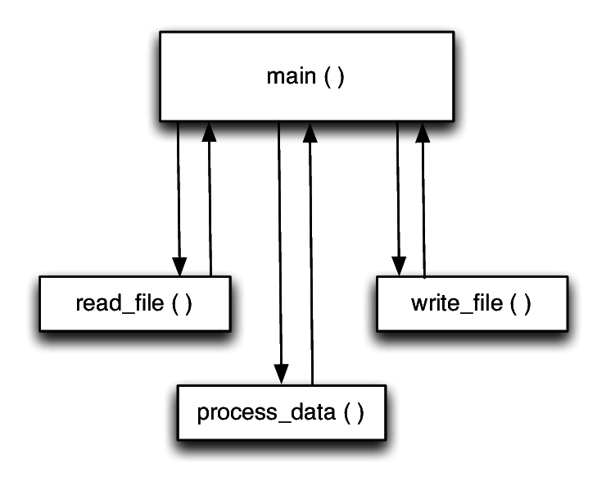
Call & Return – Main & Subroutine style

Slide 33
Call & Return – Main & Subroutine style
def calculate_sum(a, b):
result = a + b
return result
def calculate_product(x, y):
result = x * y
return result
def calculate_average(numbers):
total = sum(numbers)
average = total / len(numbers)
return average
# Main program
num1 = 5
num2 = 3
# Call the subroutines
sum_result = calculate_sum(num1, num2)
print("Sum:", sum_result)
product_result = calculate_product(num1, num2)
print("Product:", product_result)
numbers_list = [10, 15, 20, 25, 30]
average_result = calculate_average(numbers_list)
print("Average:", average_result)
The main program coordinates the execution of the calculate_sum, calculate_product, and calculate_average subroutines, each of which performs a specific mathematical calculation. The main program passes input data to the subroutines and receives results for further processing or output.

Slide 34
Call & Return – RPC
In RPC a variant of the Call and Return style, client program initiates a procedure or function call on a remote server, which executes the requested procedure and returns the result to the client. This interaction resembles the traditional call and return mechanism, but it occurs across a network or between different processes or systems.
Features:
Client-Server Model: RPC typically involves a client and a server. The client makes a procedure call as if it were a local call, and the server executes the requested procedure.
Remote Invocation: The client program invokes a procedure or method located on a remote server, possibly on a different machine or in a different address space.
Parameter Passing: Parameters or arguments are passed from the client to the server along with the procedure call. These parameters are serialized, sent over the network, and then deserialized on the server side.
Communication: RPC mechanisms handle the underlying communication between the client and server, including issues like data serialization, network communication, and error handling.
Synchronous or Asynchronous: RPC can be synchronous, where the client waits for the server's response before continuing, or asynchronous, where the client proceeds without waiting for a response.
Transparency: RPC systems aim to provide transparency to the client, making remote calls appear similar to local function calls.

Slide 35
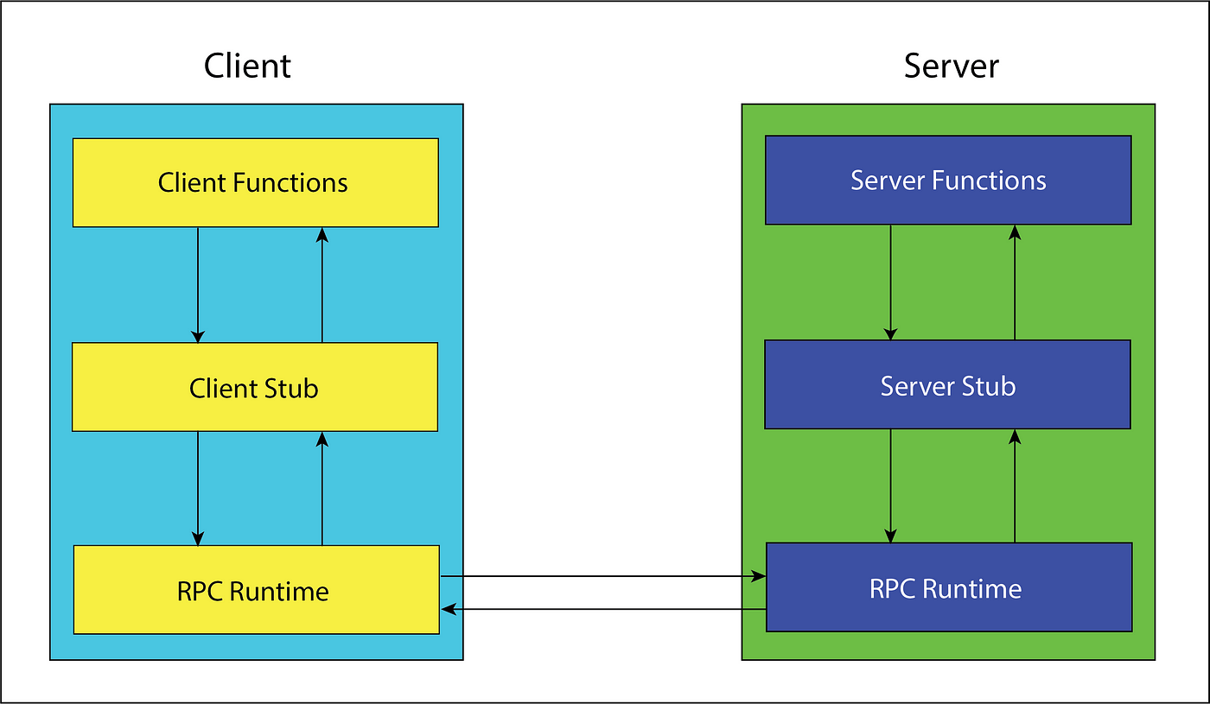
Call & Return – RPC

Slide 36
Shared Memory style (Data Centered Architecture)
Repository
Black board
Rule based

Slide 37
Shared Memory Style
The Shared Memory architectural style, also known as Shared Memory Parallelism, is a design pattern used in parallel computing and multiprocessor systems. It allows multiple processes or threads to access a shared region of memory for communication and data exchange. This architectural style is primarily used to achieve parallelism and concurrency in computing systems.
Key Concepts of the Shared Memory Architectural Style:
Shared Memory: Processes or threads can access a common region of memory, known as shared memory, which is used for communication. This shared memory acts as a data buffer where data can be read from and written to by multiple processes concurrently.
Parallelism: Shared memory systems are designed to take advantage of multi-core processors and multiprocessor architectures. Multiple threads or processes can execute in parallel, each accessing shared memory for communication.
Communication: Processes or threads communicate by reading and writing data in shared memory. This enables them to exchange information, synchronize their actions, and collaborate on tasks.
Synchronization: Synchronization mechanisms, such as locks, semaphores, or mutexes, are often used to coordinate access to shared memory to prevent conflicts and ensure data consistency.

Slide 38
Shared Memory Style
Shared memory architectures are commonly used in parallel programming and are a fundamental concept in multiprocessing and multithreading environments, providing a powerful means to harness the computational resources of modern hardware.
# Shared memory (global variable as shared memory)
shared_data = "Hello, Shared Memory!"
# Function to read the shared data
def read_shared_data():
global shared_data
return shared_data
# Function to update the shared data
def update_shared_data(new_value):
global shared_data
shared_data = new_value
# Initial value
print("Initial Shared Data:", read_shared_data())
# Update the shared data
update_shared_data("Updated Shared Data!")
# New value
print("Updated Shared Data:", read_shared_data())

Slide 39
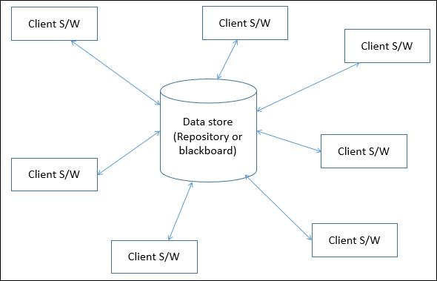
Shared Memory Style
(REPOSITORY)

Slide 40
Shared Memory Style -REPOSITORY
What Is It? Imagine you have a magic box where you keep your toys. Instead of reaching into the box and grabbing a toy directly, you always ask your helpful toy librarian for a toy. The librarian knows where all the toys are and gives you the right one when you ask. You don't need to worry about where the toys are stored or how to get them; you just talk to the librarian.
In Software Terms:
  The magic box is where we store important information, like user names or game scores.
  The toy librarian is like a special computer program called a "Repository."
  You, the user of the program, don't need to know where the information is stored or how to get it. You just talk to the Repository, and it gets the information for you.
Why Is It Useful?
  It makes things simpler because you don't have to think about where the data is.
  It helps if you want to change where you store your information (like moving your toys to a different box). You only need to teach the librarian, not everyone who uses the toys.

Slide 41
Shared Memory Style -REPOSITORY
The Repository architectural style is a software architecture design pattern that separates the logic that retrieves data from the underlying storage or database (the "repository") from the rest of the application.
This separation is achieved through a well-defined interface or API that allows the application to access data without being concerned about how the data is actually stored or retrieved.

Slide 42
REPOSITORY – Key Characteristics
Abstraction of Data Access: The primary goal of the Repository pattern is to abstract or encapsulate the details of data access. It provides a clean separation between the application's data access code and the underlying data storage, such as a database, file system, or web service.
Single Point of Entry: The Repository serves as a single point of entry for the application to interact with the data storage. Instead of scattering data access code throughout the application, developers access data exclusively through the Repository interface.
Data Access Logic: The Repository contains all the data access logic, including CRUD (Create, Read, Update, Delete) operations. It translates high-level application calls into database queries or other data retrieval methods.

Slide 43
REPOSITORY – Key Characteristics
Decoupling: By abstracting data access, the Repository pattern promotes loose coupling between the application's business logic and the data storage. Changes to the data storage mechanism or database schema can be isolated to the Repository implementation.
Testing: Separating data access logic makes it easier to test the application's core business logic independently of the data storage. Mocking or substituting the Repository during testing allows for more controlled and predictable testing scenarios.
Maintainability: The Repository pattern contributes to code maintainability by consolidating data access logic in one place. Developers can focus on writing business logic without being concerned about database details.
Extensibility: It's relatively straightforward to extend or replace the Repository implementation if the application's data access needs change. For example, you can switch from a relational database to a NoSQL database without altering the application's core logic.

Slide 44
REPOSITORY – Key Characteristics
Examples: The Repository pattern is commonly used in web applications, where it abstracts the data access layer from the rest of the application. Popular frameworks like Spring Data JPA (Java), Entity Framework (C#), and Django ORM (Python) utilize this pattern.

Slide 45
REPOSITORY – Program that demonstrates the Repository architectural style using a list to store and manage data
# Acts as repository. Stores user data in a list “users”
class UserRepository:
def __init__(self):
self.users = []
# add users to the list
def add_user(self, username):
self.users.append(username)
# retrieve users from the repo
def get_users(self):
return self.users
# Create a UserRepository instance
repository = UserRepository()
# Add users to the repository
repository.add_user("Alice")
repository.add_user("Bob")
repository.add_user("Charlie")
# Get and print the list of users from the repository
users = repository.get_users()
for user in users:
print("User:", user)

Slide 46
Shared Memory Style
(REPOSITORY)…
A repository architecture consists of a central data structure (often a database) and a collection of independent components which operate on the central data structure.
Subsystems access and modify data from a single data structure called the repository
Subsystems are loosely coupled (interact only through the repository)
Control flow is dictated by the repository through triggers or by the subsystems through locks and synchronization primitives

Slide 47
Shared Memory Style - Black board
The Blackboard architectural style is a design pattern used in complex and knowledge-intensive systems where multiple specialized modules or agents collaborate to solve a problem.
It's often employed in situations where a problem cannot be solved by a single algorithm or where different algorithms or knowledge sources need to work together to find a solution.

Slide 48
Black board Components
Blackboard: The central data structure, often referred to as the "blackboard," contains the problem-solving state. It's a shared space where all the specialized modules read and write data. The blackboard holds the current problem state, and modules communicate by reading and updating this shared data structure.
Knowledge Sources (Modules): These are specialized software components or modules that contribute their expertise or algorithms to solving the problem. Each knowledge source has a specific area of expertise and can read from and write to the blackboard. Knowledge sources can be added, removed, or modified independently, making the architecture flexible and extensible.
Controller: The controller, also known as the "scheduler" or "director," manages the flow of problem-solving. It decides when to activate specific knowledge sources based on the current state of the blackboard and problem-solving objectives. The controller aims to maximize the efficiency and effectiveness of the problem-solving process.

Slide 49
Black board Characteristics
Loose Coupling: The Blackboard architecture promotes loose coupling between knowledge sources. Modules operate independently, focusing on their specific tasks and only accessing the blackboard when needed. This loose coupling allows for easy addition or replacement of knowledge sources.
Collaboration: Knowledge sources collaborate by sharing information on the blackboard. They can read and write data, making it possible for the system to integrate diverse sources of knowledge and expertise.
Parallelism: Since knowledge sources can work independently and in parallel, the Blackboard style is suitable for systems requiring high levels of concurrency and parallel processing.

Slide 50
Black board example
Consider a medical diagnosis system as an example. The blackboard stores patient data, symptoms, and test results.
Knowledge sources may include modules for interpreting lab results, recognizing symptoms, and identifying potential diseases.
The controller decides which knowledge sources to activate based on the patient's data and the problem-solving goals. As new research or diagnostic methods emerge, new knowledge sources can be added to enhance the system's capabilities.

Slide 51
Black board
Imagine you have a big chalkboard (the "Blackboard") where everyone can see and write things.
How it works:
The Chalkboard (Blackboard): This is where all the information related to the problem is written. It's shared among a group of experts who are trying to solve the problem. They write their findings, ideas, or solutions on this chalkboard.
The Experts (Knowledge Sources): These are like specialists in different areas. Each expert knows a part of the solution, but none of them knows everything. They read what's on the chalkboard and add their own knowledge when it's relevant.
The Coordinator (Controller): This is someone who looks at what's on the chalkboard and decides which expert's knowledge should be used at a given time. They make sure that the right experts are working on the problem at the right time.
Collaboration: Experts collaborate by reading what's on the chalkboard and adding their insights. They don't work in isolation; they work together on the same problem by sharing information.

Slide 52
Black board
import random
# Expert 1: Adds two numbers
def expert_addition(a, b):
return a + b
# Expert 2: Subtracts two numbers
def expert_subtraction(a, b):
return a - b
# Expert 3: Multiplies two numbers
def expert_multiplication(a, b):
return a * b
# Expert 4: Divides two numbers
def expert_division(a, b):
if b == 0:
return "Undefined (division by zero)"
return a / b

Slide 53
Black board
# Blackboard: The main problem-solving area
def blackboard(a, b):
# Select a random expert
expert = random.choice([expert_addition, expert_subtraction, expert_multiplication, expert_division])
# Let the selected expert work on the problem
result = expert(a, b)
# Print the selected expert and their solution
print(f"Selected Expert: {expert.__name__}")
print(f"Problem: {a} and {b}")
print(f"Solution: {result}")
# Main program
if __name__ == "__main__":
a = 10
b = 5
# Simulate the Blackboard by calling it multiple times
for _ in range(5):
print("\n--- New Iteration ---")
blackboard(a, b)

Slide 54
Shared Memory Style
(Black board)
This style is characterized by a central data structure and a collection of components operating on the central data store.
Characterized by three main types of components
  The knowledge source (KS) which are independent modules that contain the knowledge needed to solve the problem
  The blackboard which is a global repository containing input data and partial solutions and
  The controller which is responsible for managing the course of the problem solving

Slide 55
Shared Memory Style
(Black board)
Design elements
  Components – shared blackboard
    Independent programs a.k.a knowledge sources
  Connectors – depending on the context
    Procedure calls, database queries
Topology – star, the black board as the central node

Slide 56
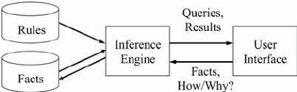
Shared Memory Style
(Rule based)

Slide 57
Shared Memory Style
(Rule based)
A list of rules or rule base, which is a specific type of knowledge base.
An inference engine or semantic reasoner, which infers information or takes action based on the interaction of input and the rule base. The interpreter executes a production system program by performing the following match-resolve-act cycle
Temporary working memory.
A user interface or other connection to the outside world through which input and output signals are received and sent.

Slide 58
Shared Memory Style
(Rule based)
The Rule-Based architectural style, also known as the Rule-Based System (RBS) architectural style, is a design pattern used in software architecture. It's particularly well-suited for applications that require complex decision-making based on a set of rules or conditions.
Components of a Rule-Based System:
Facts: These are the data inputs to the rule engine. Facts represent the current state of the system and are used by the rules to make decisions.
Rule Base: This is a collection of rules that define the logic for decision-making. Rules are typically organized and stored in a rule repository for easy management.
Inference Engine: The inference engine is responsible for selecting and applying the rules to the facts to derive conclusions or decisions. It evaluates the rule conditions against the current facts.
Working Memory: Working memory is a temporary storage area that holds facts during the rule evaluation process. It allows the inference engine to keep track of facts that are relevant to the current set of rules.

Slide 59
Shared Memory Style - Rule based
Key Characteristics of Rule-Based Architectural Style:
Rule Engine: The core of a Rule-Based system is a rule engine, which is responsible for evaluating and applying rules to make decisions. Rules are typically represented in a human-readable form and can be easily modified or extended without changing the underlying system.
Declarative Rules: Rules are usually expressed in a declarative format, meaning they specify what should be done rather than how it should be done. This makes it easier for domain experts to define and manage rules.
Separation of Concerns: Rule-Based systems promote a clear separation of concerns. The rules engine is responsible for handling rule evaluation, while the rest of the application focuses on other tasks, such as data retrieval and presentation.
Scalability: Rule-Based systems can be highly scalable since rules can be distributed across multiple rule engines or servers. This allows for parallel rule evaluation and improved performance.
E-Commerce website
Facts: Information about the user, their shopping cart, and the items in the cart.
Rule Base: Rules that define discounts, shipping options, and tax calculations based on user behavior and cart contents.
Inference Engine: This component evaluates the rules based on the current facts and decides on the final pricing, shipping method, and tax amount.

Slide 60
Shared Memory Style - Rule based
class Rule:
def __init__(self, condition, result):
self.condition = condition
self.result = result
def evaluate(self, facts):
if eval(self.condition, facts):
return self.result
return None
class RuleEngine:
def __init__(self):
self.rules = []
def add_rule(self, condition, result):
self.rules.append(Rule(condition, result))
def execute(self, facts):
for rule in self.rules:
result = rule.evaluate(facts)
if result is not None:
return result
return "Loan application status: Undecided"

Slide 61
Shared Memory Style - Rule based
# Create a rule engine
engine = RuleEngine()
# Add rules to the engine
engine.add_rule("income > 50000 and credit_score >= 700", "Loan approved")
engine.add_rule("income <= 50000 or credit_score < 700", "Loan denied")
# Define facts
facts = {"income": 60000, "credit_score": 720}
# Execute the rule engine
result = engine.execute(facts)
# Display the result
print(result)

Slide 62
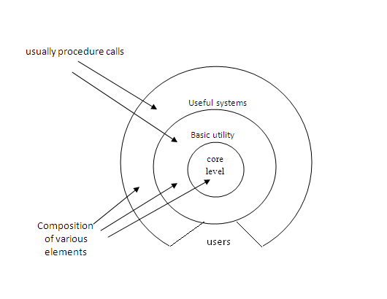
LAYERED STYLE

Slide 63
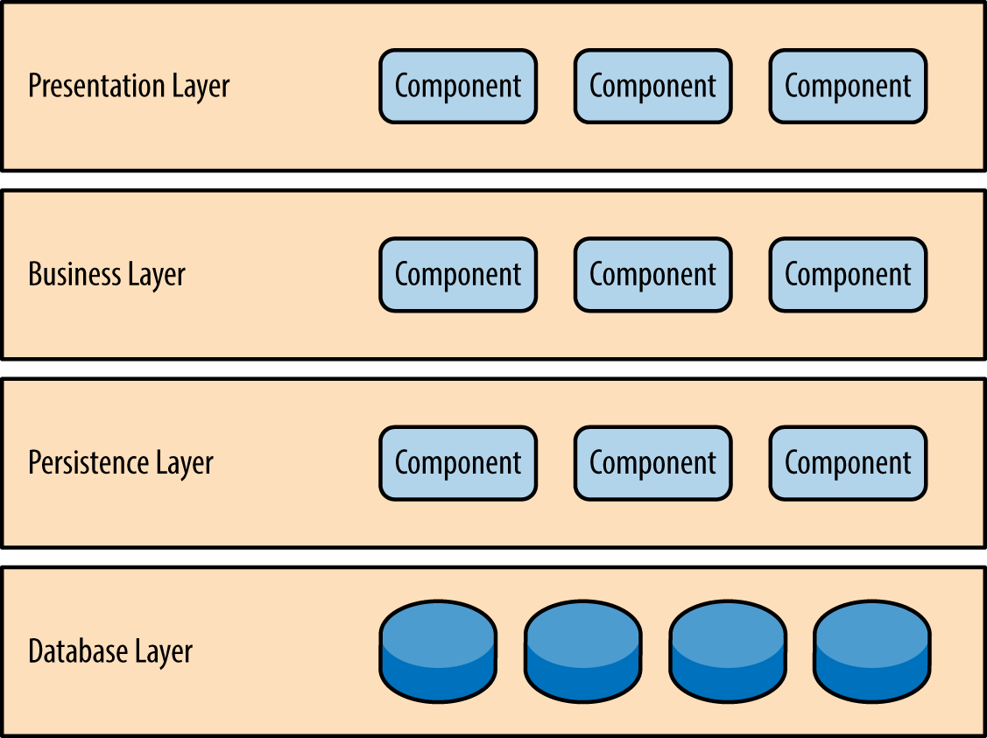
LAYERED STYLE

Slide 64
LAYERED STYLE
An ordered sequence of layers, each layer offers services (interfaces) that can be used by programs (components) residing with the layer(s) above it.
In this, the components are assigned to layers to control inter component interaction. In the pure version of this architecture, each level communicates only with its immediate neighbours.
The goal is to achieve the qualities of modifiability and portability.
Layer bridging: functions is one layer may talk to other than its immediate neighbor
Each layer acts as a
  Server: service provider to layer above
  Client: service consumer of the layer below
  Strict and non-strict layering

Slide 65
LAYERED STYLE
Design elements:
  Components – layers, each layer usually several programs
  Connectors – typically procedure calls
  Data – parameters passed between layers
Topology
  Strict and relaxed layering

Slide 66
Advantages and Disadvantages
Advantages
  They support designs based on increasing levels abstraction.
  Allows implementers to partition a complex problem into a sequence of incremental steps.
  They support enhancement
  They support reuse.
Disadvantages
  Not easily all systems can be structures in a layered fashion.
  Performance may require closer coupling between logically high-level functions and their lower-level implementations.

Slide 67
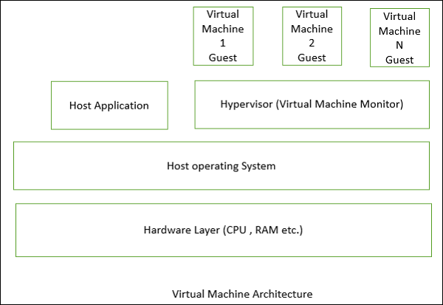
LAYERED STYLE
(VIRTUAL MACHINES)
Virtual machines are SWA style that simulate some functionality that is not native to the hardware and/or software on which it is implemented.

Slide 68
VM benefits
It can allow one to simulate (and test) platforms that have not yet been built (such as new hardware), and it can simulate "disaster'' modes (as is common in flight simulators and safety-critical systems) that would be too complex, costly, or dangerous to test with the real system.
Common examples of virtual machines are interpreters, rule-based systems, syntactic shells, and command language processors

Slide 69
LAYERED STYLE
(Client - Server)
Similar to layered style
Only two layers
  Clients
  Server
One or many servers provide services to instances of subsystems, called clients
Each client calls on the server, which performs some service and returns the result
The clients know the interface of the server The server does not need to know the interface of the client
The response in general is immediate
End users interact only with the client.
Design elements
Topology
  Two level, multiple clients making requests to server
  Components - clients and server
  Connectors – RPC, network protocols
  Data – parameters and return values

Slide 70
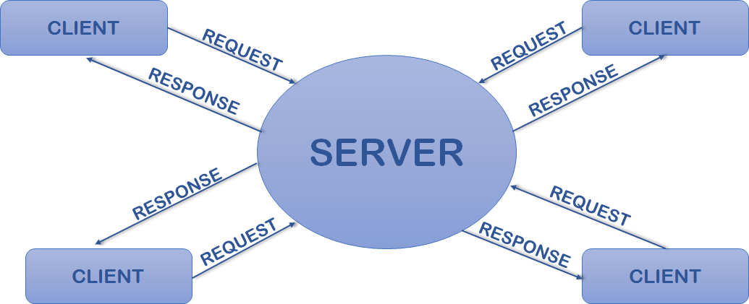
LAYERED STYLE
(Client - Server)

Slide 71
CS – e.g Library Management System
Client -end: User application (LMS)
  Customized user interface
  Front-end processing of data
  Initiation of server remote procedure calls
  Access to database server across the network
Server-end: Database access and manipulation (server)
  Centralized data management
  Data integrity and database consistency
  Database security
  Concurrent operations (multiple user access)
  Centralized processing (for example archiving)

Slide 72
Thick and Thin Clients
Thick (or “fat”) client ( with data storage facility - HDD)
  Does as much processing as possible
  Passes only data required for communications and archival storage to the server
  Advantages: less network bandwidth, fewer server requirements
Thin client ( only OS and Browser in ROM)
  Has little or no application logic
  Depends primarily on the server for processing activities
  Advantages: lower IT admin costs, easier to secure, lower hardware costs.

Slide 73
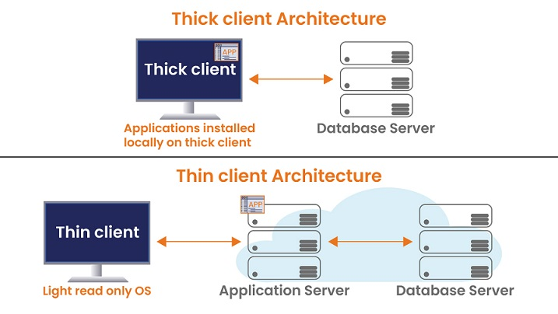
Thick and Thin Clients

